Slide 1
Course Name: Application Development Workshop
Documentation Version: 2.0
Last Update: 09/15/2022
Description
Intended Audience
Supporting Content & Materials
Course Outline
Developer, SA
Lab tutorial: Developer_Bootcamp_EN/5_Application_Development · master · enos-cat / training / developer_bootcamp · GitLab (envisioncn.com)
Difficulty Level
100 / 200 / 300 / 400
Get the Service Account (SA) for application development.
Develop a demo application in a Java or Python project.
Call EnOS APIs to get the data of the target devices.
Delivery Method
Classroom
Online
Self-paced / Video
Course Modality
Lecture (PPT, Demo)
Lab
Workshop
Duration
2 hour
Available

Slide 2
305
Application Development Workshop

Slide 3

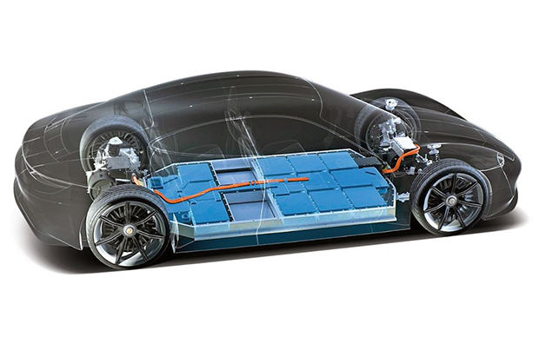
Objectives
Learn how to invoke EnOS APIs and SDK
Put everything you learnt together to develop a simple smart battery demo app to:
Show general information of battery devices
Show real-time telemetry data
Show alert records
Show analytical results

Slide 4
Preparations & Prerequisites
Before starting the Lab, you need to complete the following preparation:
Complete the Workshop 302: Device Connectivity & Management step by step to simulate device data by EnOS Java Core SDK and ensure that your device can ingest the simulated data.
Complete the Workshop 303: Data Asset Management step by step to store time-series data properly and generate stream analytics data properly, both of which need to be retrievable through APIs.
Get the proper permissions to invoke EnOS APIs (If you are in a training, this is done by the trainer).

Slide 5
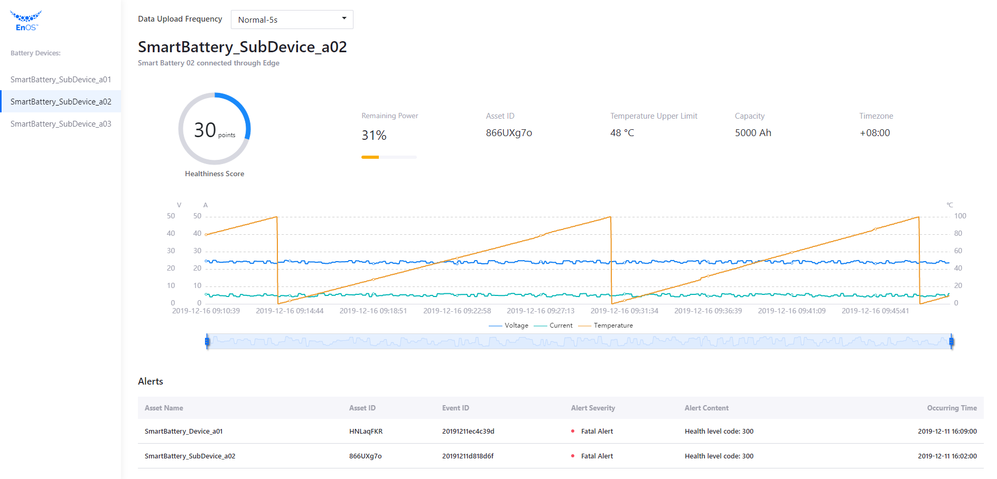
Smart Battery Demo App Features
Manage battery assets, which are distributed all over the world
Monitor the running states of batteries, visualize the following time-series data and observe the trends:
Voltage
Current
Temperature
Perform the following tasks through the collected data, as well as the design specification of the battery:
Calculate remaining power
Analyze health level
Monitor data quality
Control the battery – to change the data upload frequency
Throw alerts – high temperature typically indicates a potential risks

Slide 6





Environment Preparation
If you choose Java
If you choose Python
IDE
Java SE 8
Python
IntelliJ IDEA
Community Edition for JVM and Android development
Development Kit 8 or above version
Python 3.7.5
Maven 3
Pycharm
Community Edition for pure Python development
Apache Maven 3 or above version

Slide 7
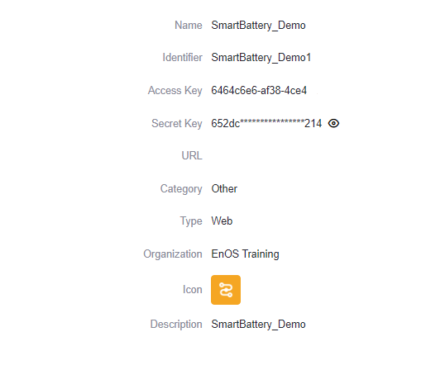
Getting the Service Account
The Service Account(SA) is a special EnOS account, which is required when an application accesses the resources on EnOS through APIs. To develop an application based on EnOS APIs, you need to get application SA on the EnOS Management Console.
You can get an application SA by the following steps:
1. Log in to the EnOS Management Console and select Application Registration on the left navigation menu.
2. On the Apps of This OU tab, click the SmartBattery_Demo application card to open App Detail page.
3. In the App Detail page, find and save the AccessKey and SecretKey of the application.

Slide 8
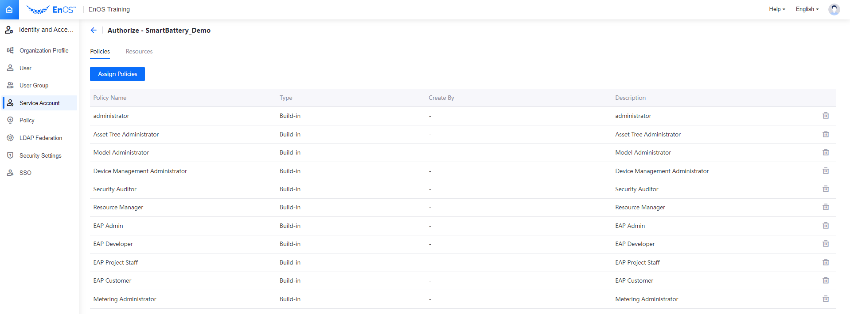
Application SA Authorization
Before the application starts, be sure the application SA is authorized enough permissions to access the assets.

Slide 9
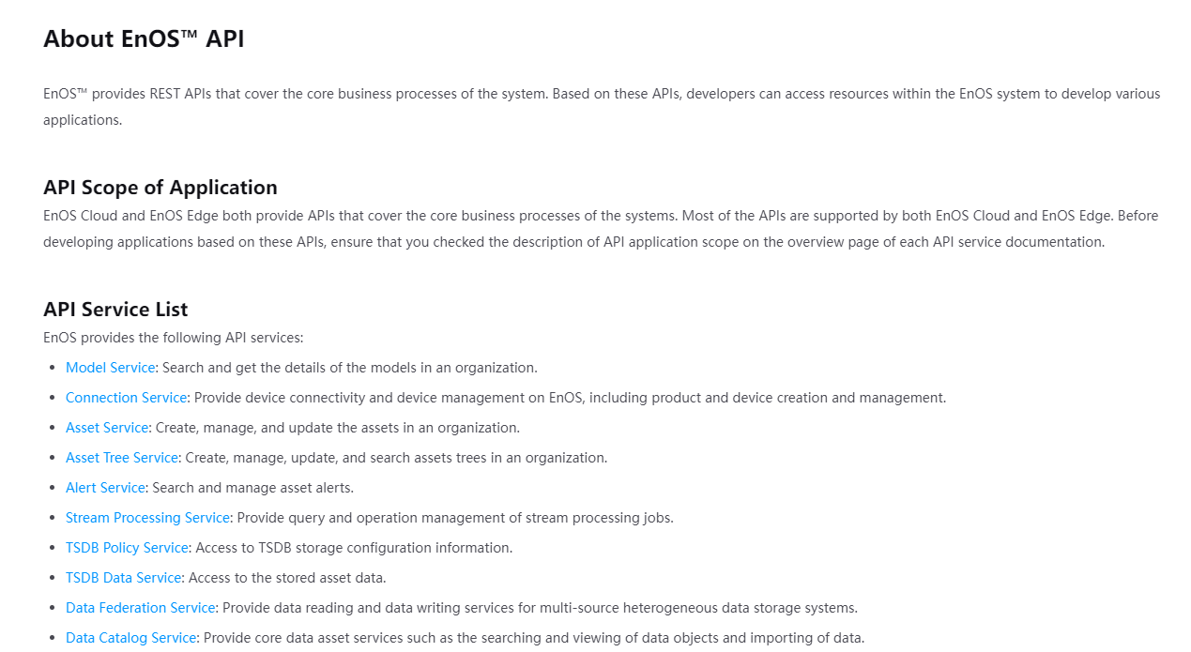
EnOS API Documentation
Obtain the API documentation from EnOS Management Console > Help > EnOS APIs and get familiar with the usage of the EnOS APIs.

Slide 10
Step by Step
Choose the developing environment: Java or Python, download the demo source code
Import the project and get familiar with the source code infrastructure
Get the battery asset list
Get the battery asset information
Get the battery status: health level and remaining power
Get the dynamic battery data and display the data in a chart
Get the active alerts of the battery asset tree
Send service command to control the data upload frequency
Finish the battery app and see the results

Slide 11
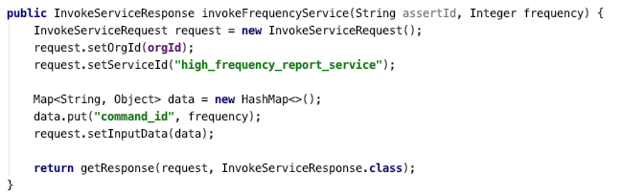
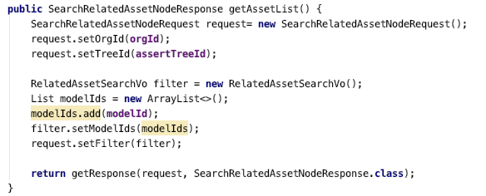
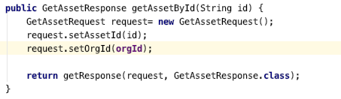
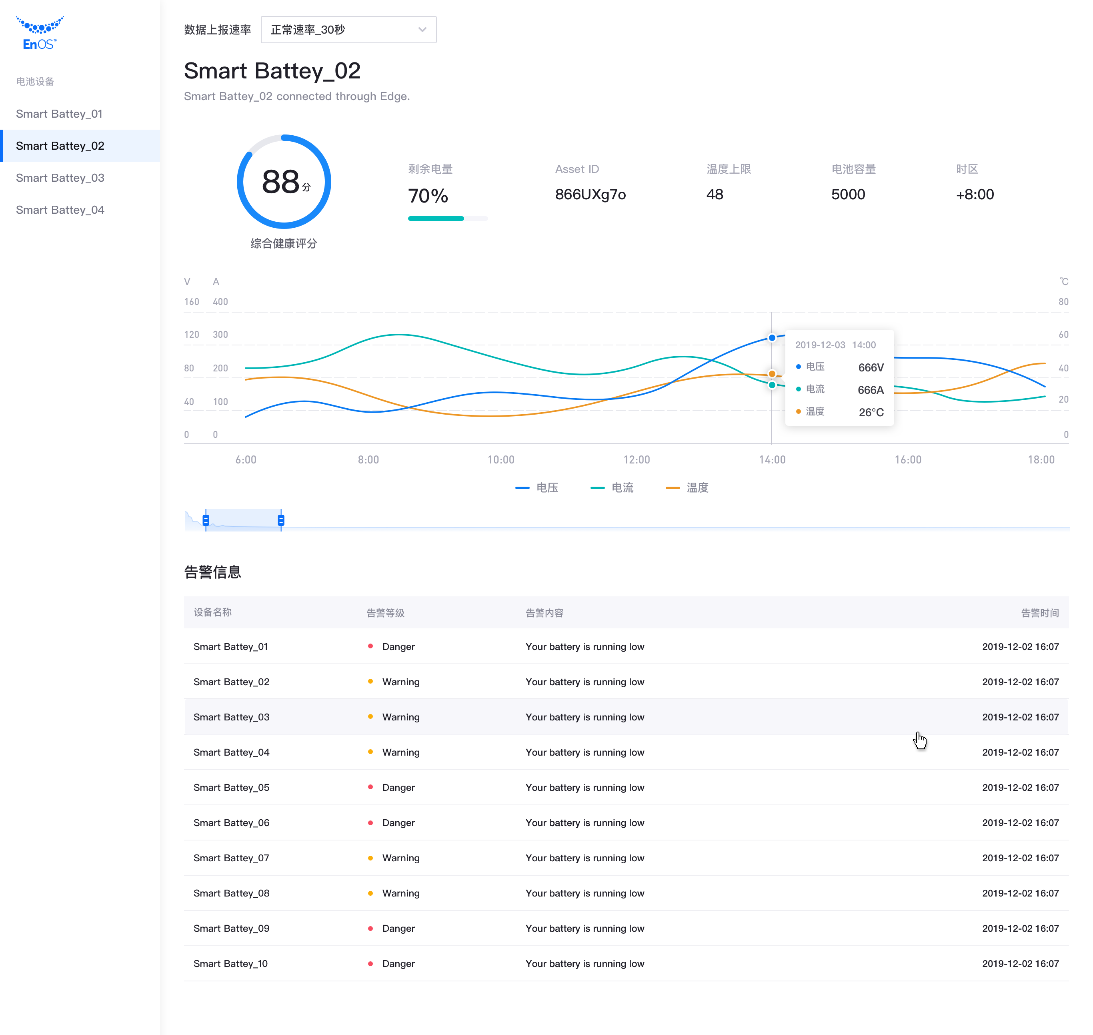
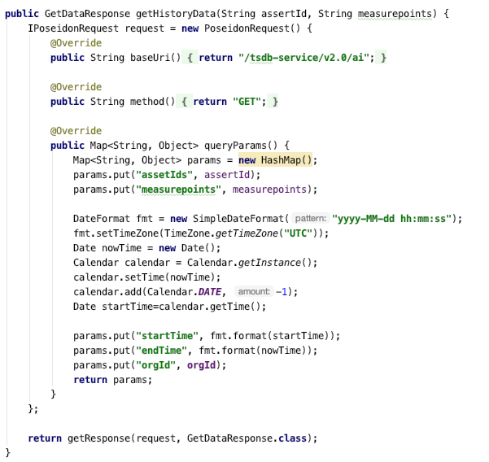
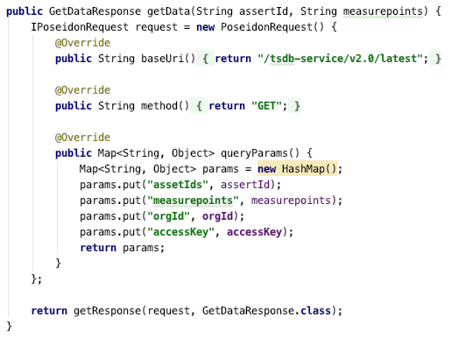
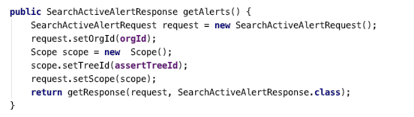
Java

Slide 12
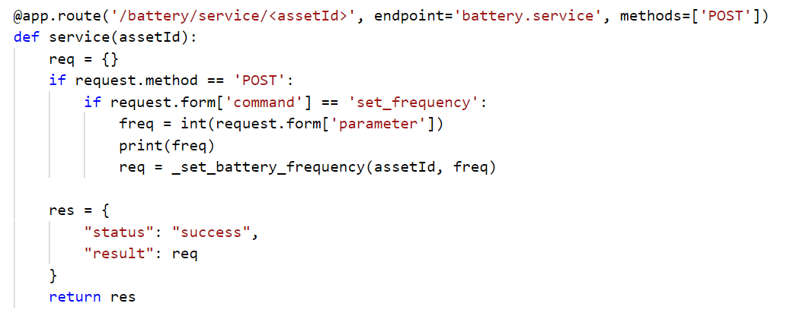
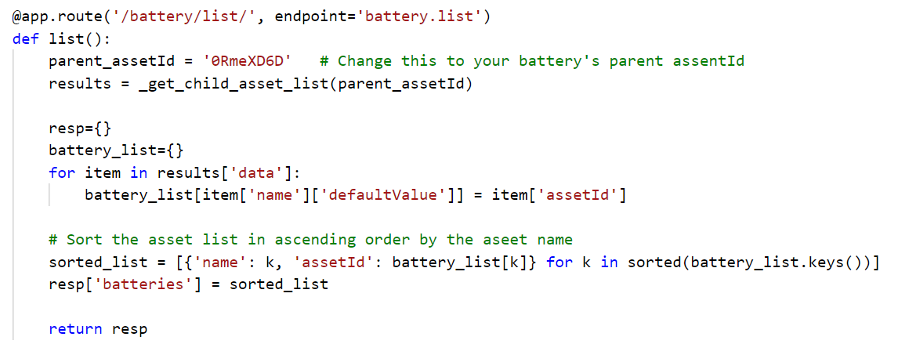
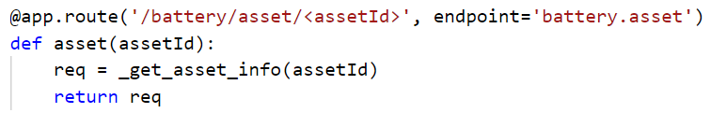
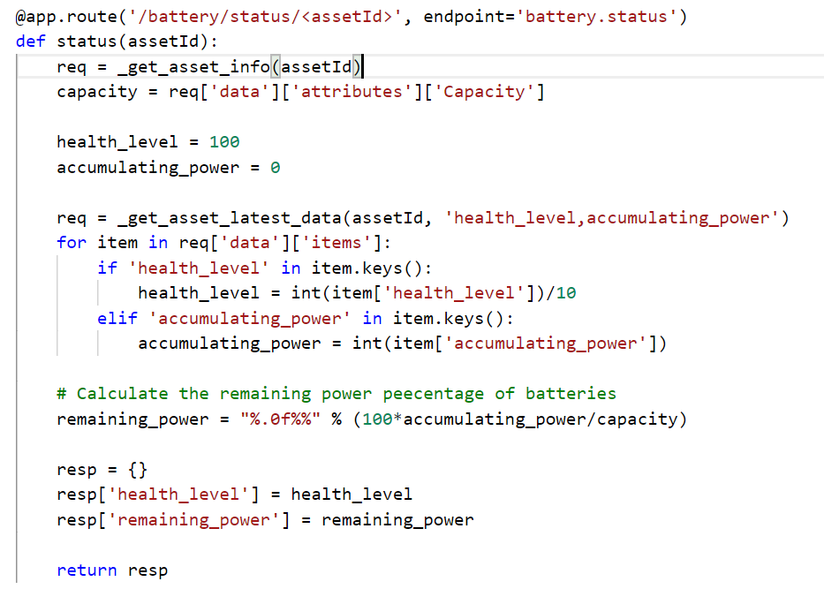
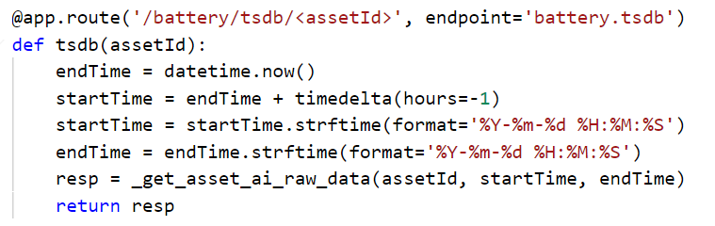
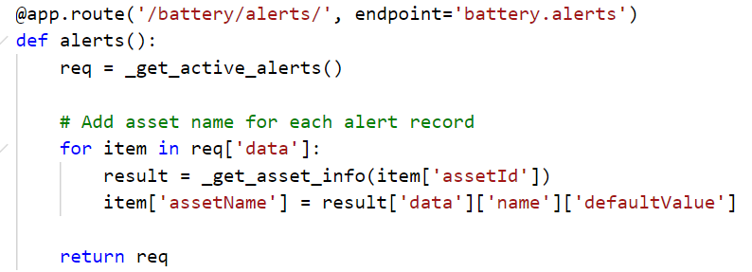
Python

Slide 13
Recap
Learn how to invoke EnOS APIs and SDK
Put everything you learnt together to develop a simple smart battery demo application to:
Show general information of battery devices
Show real-time telemetry data
Show alert records
Show analytical results

Slide 14


Solving the Challenges for a Sustainable Future

